Slide 1
Grade 5 Power Play
Young Entrepreneurs
Ordering Catalog

Slide 2
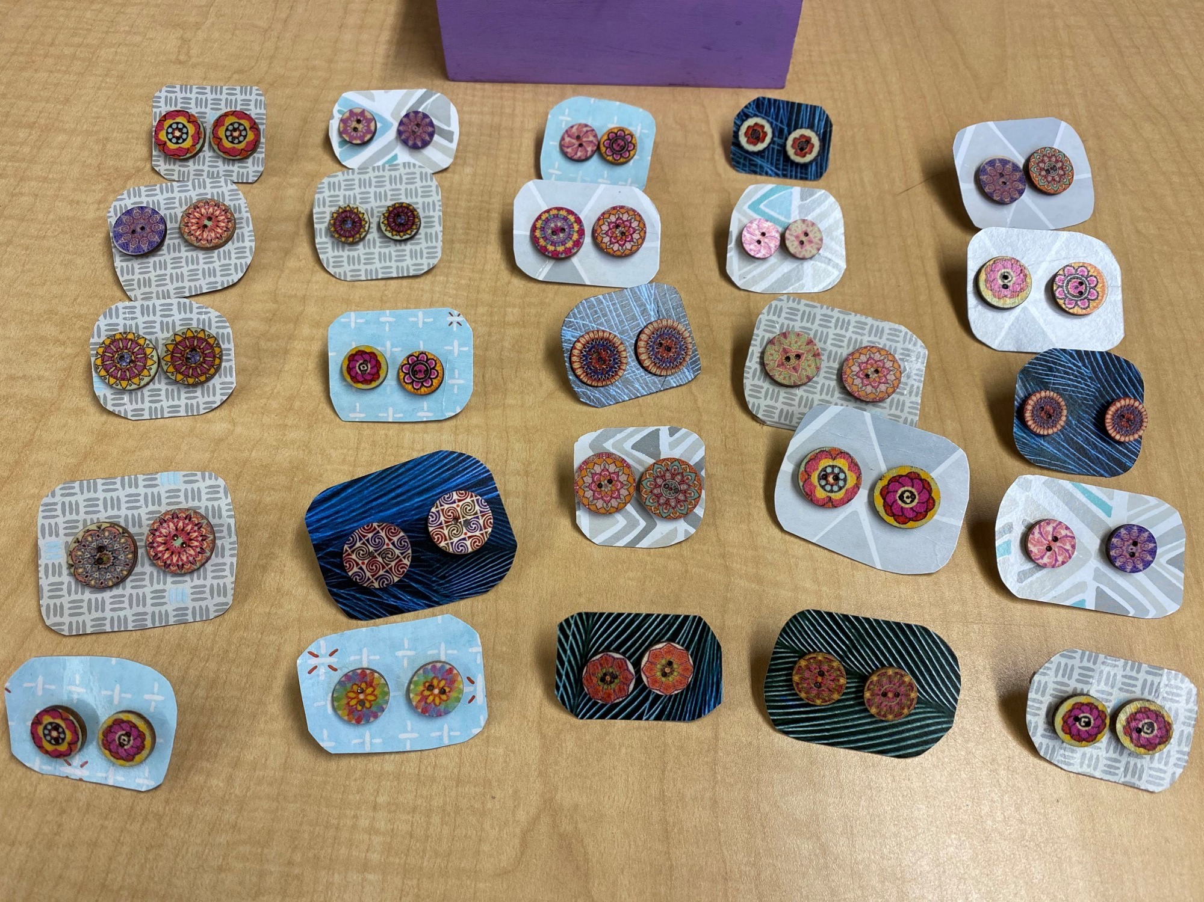
Exquisite Earrings
$3.50 Each
For a little colour on your ears
Order from Lily

Slide 3
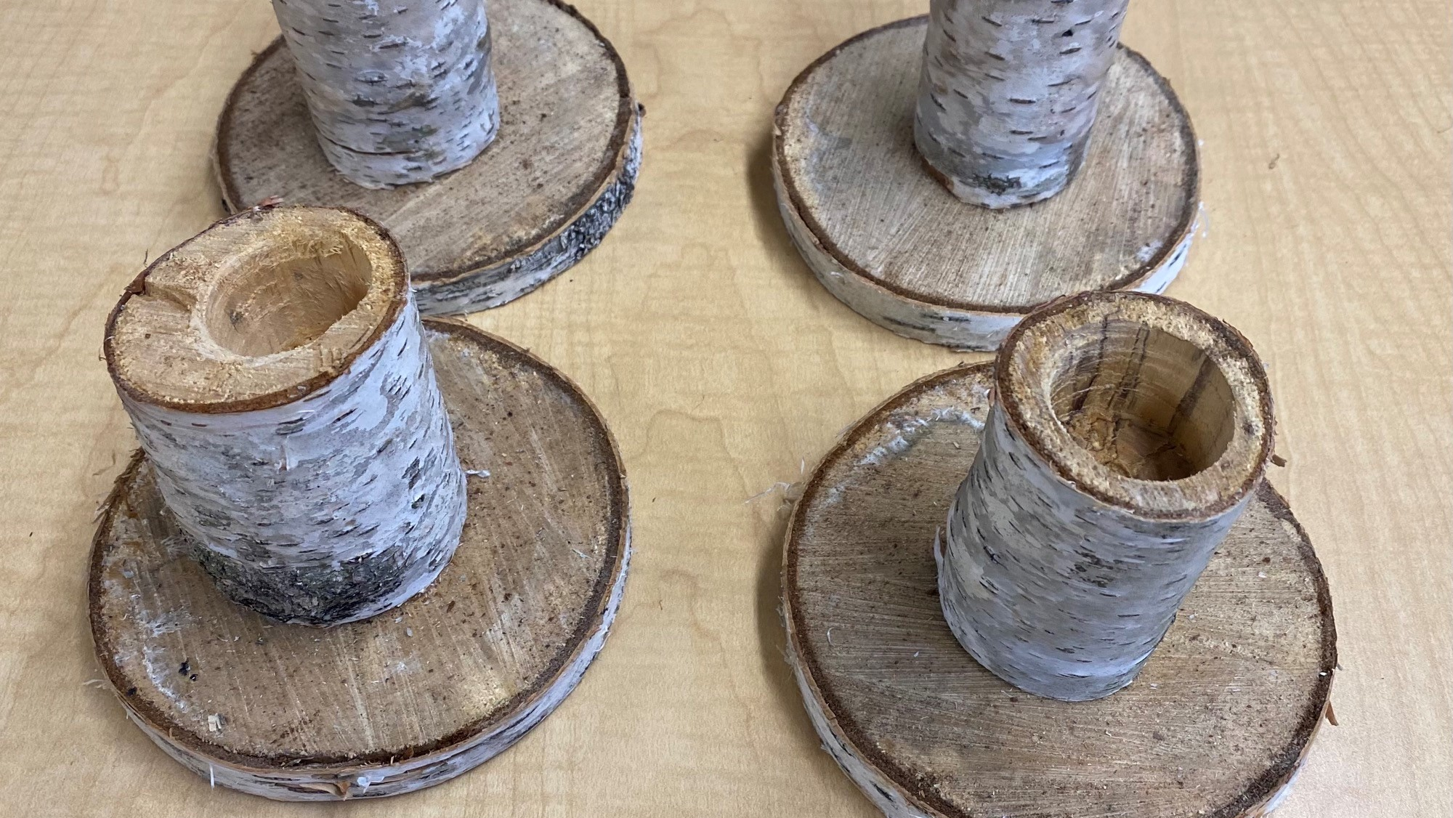
Wyatt’s
Wacky
Wooden
Pen Holders
$3.00 Each
Order from Wyatt

Slide 4
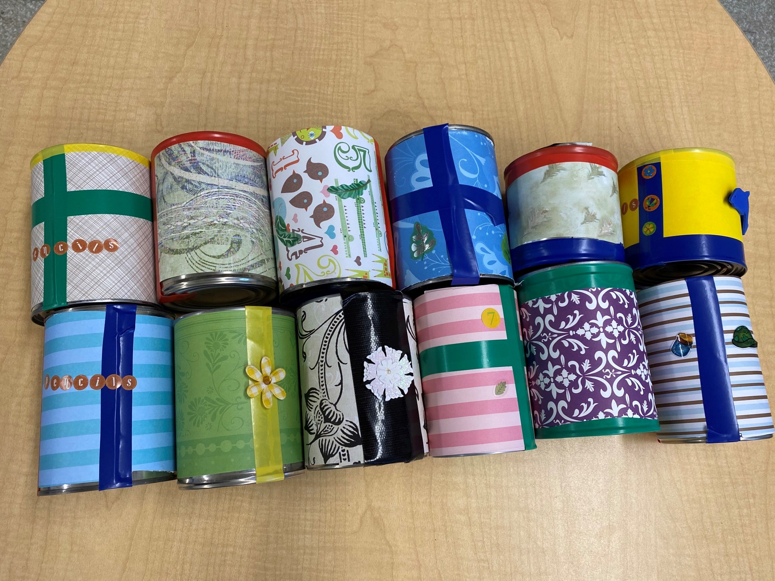
Colourful Cans
$3.00
Never look for a pencil again!
Order from Will

Slide 5
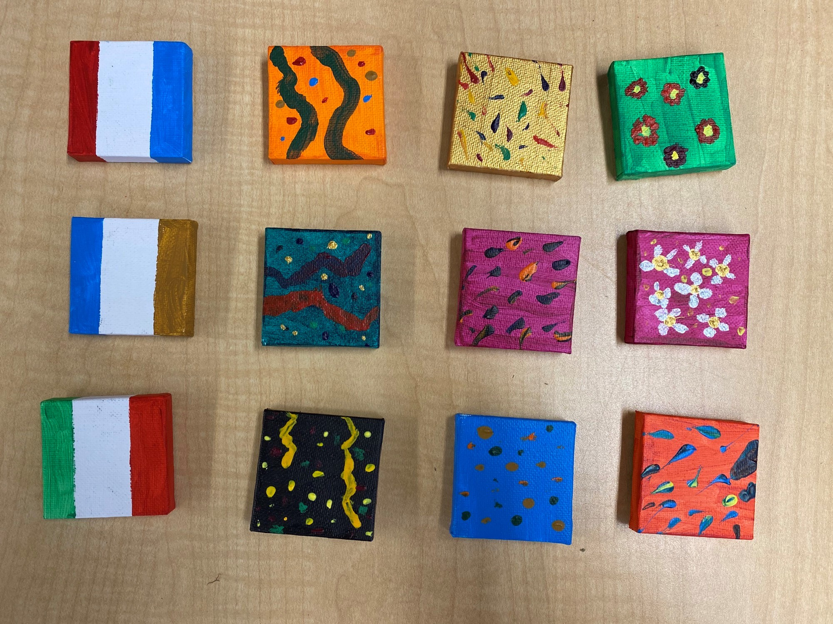
Spencer’s Special Squares
$3.50
They are great for your locker and fridge.
Order from Spencer

Slide 6
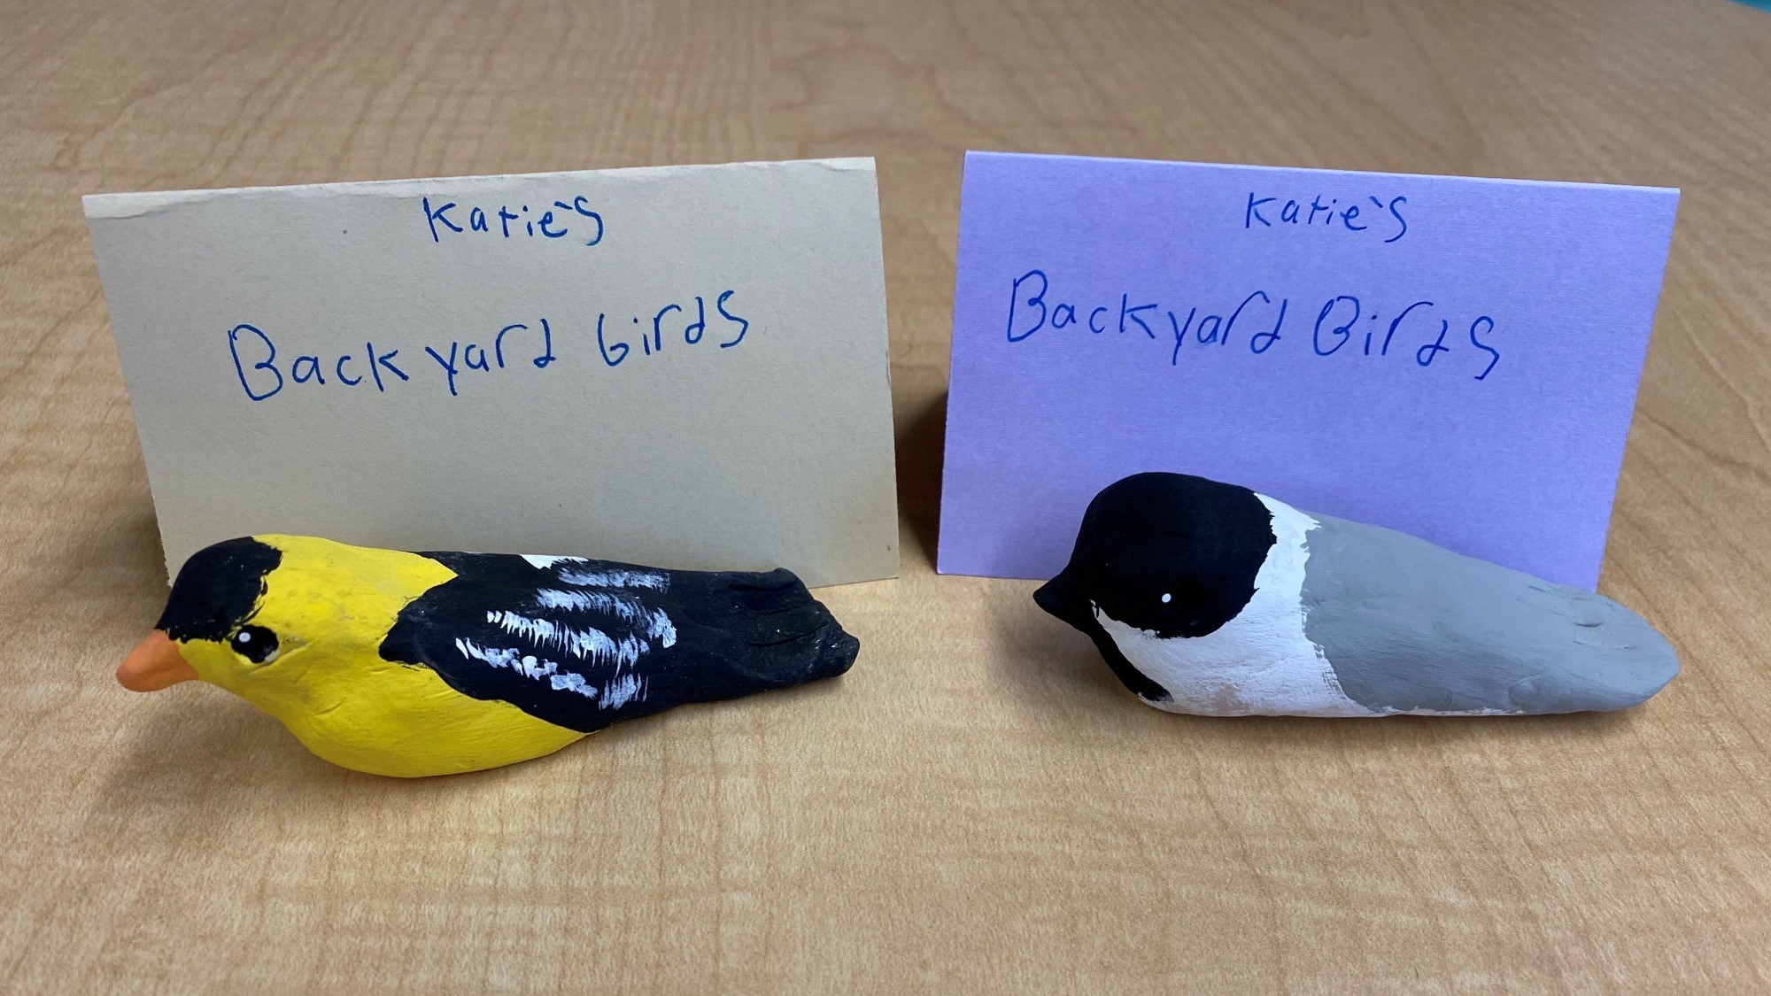
Katie’s Backyard Birds
$3.50
These birds will make you chirp with excitement!
Order from Katie

Slide 7
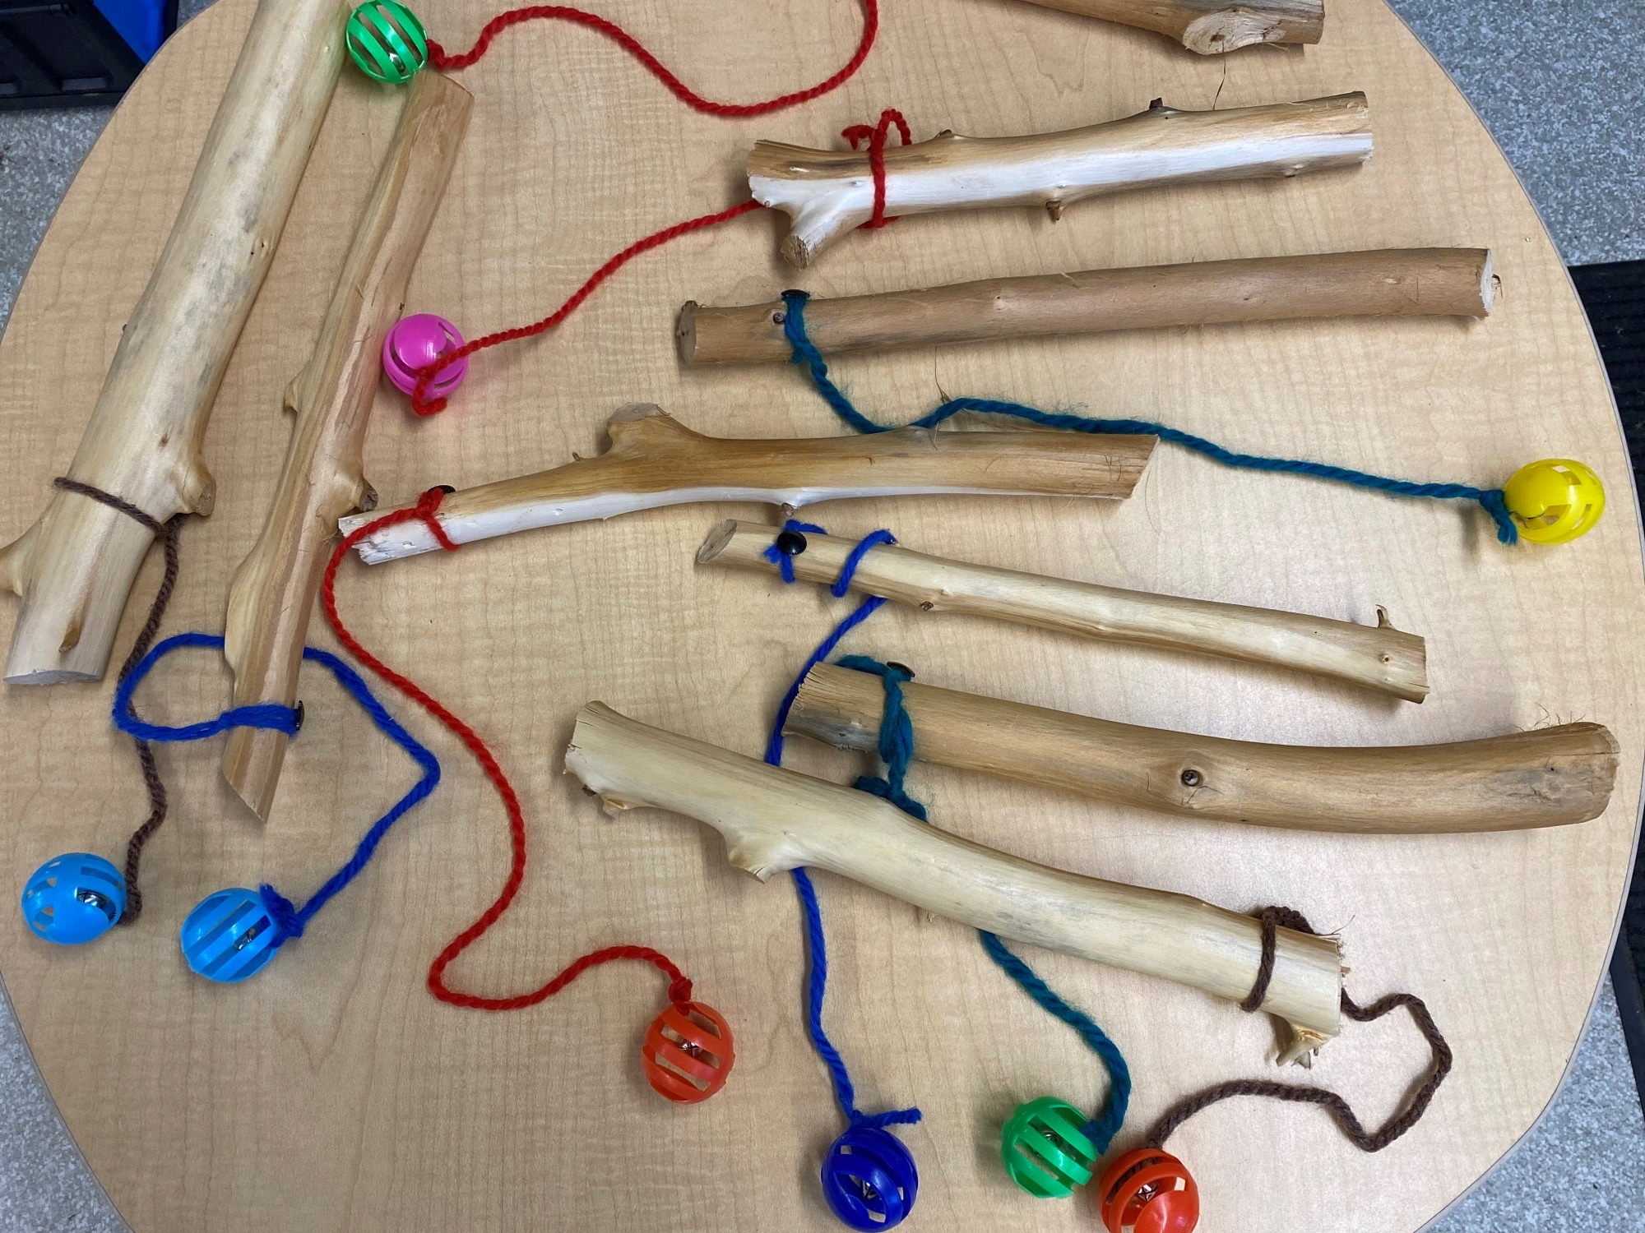
Cute
Kitty
Cat
Toys
$3.00
Order from Gavin

Slide 8
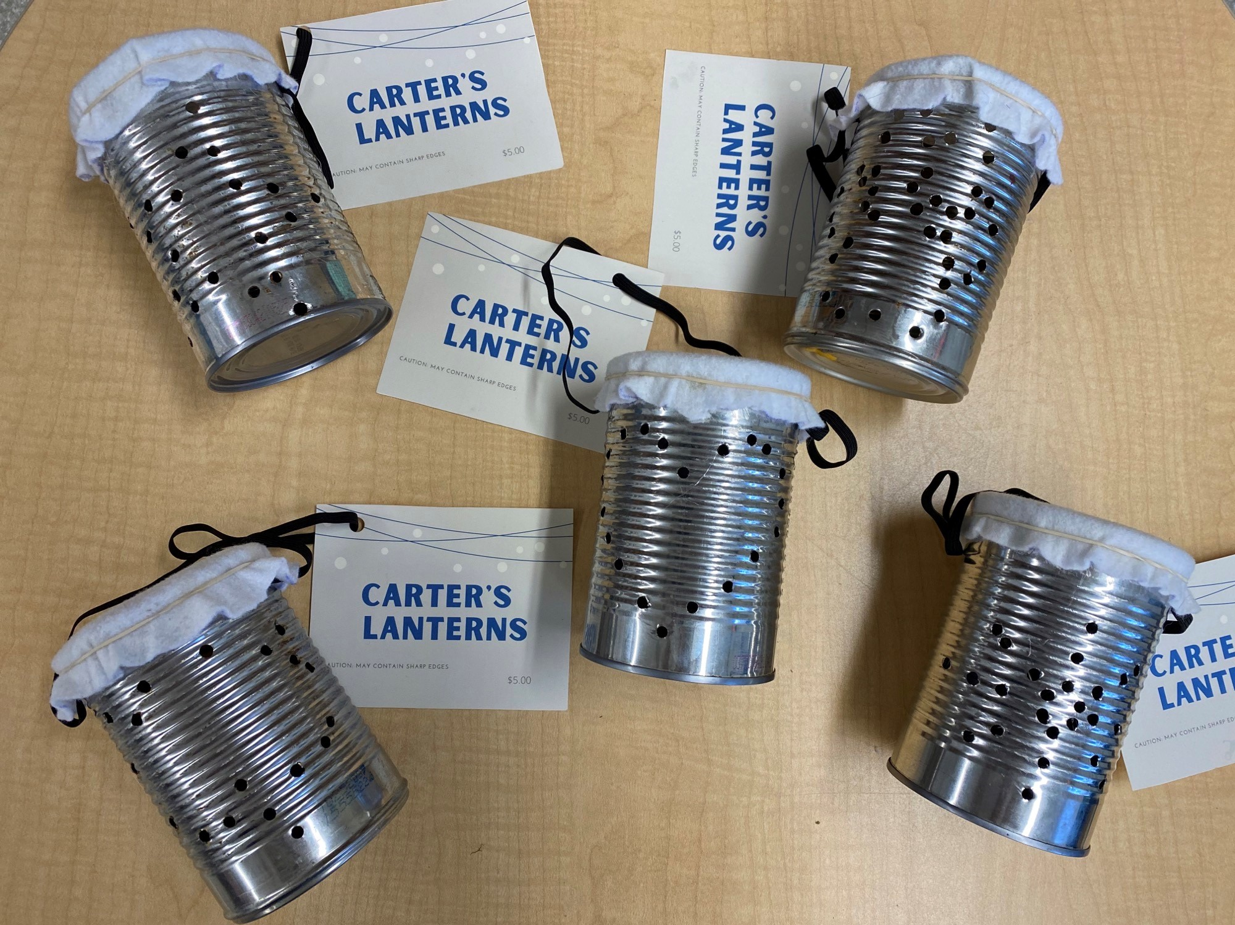
Carter’s Lanterns
$5.00
Order from Carter

Slide 9
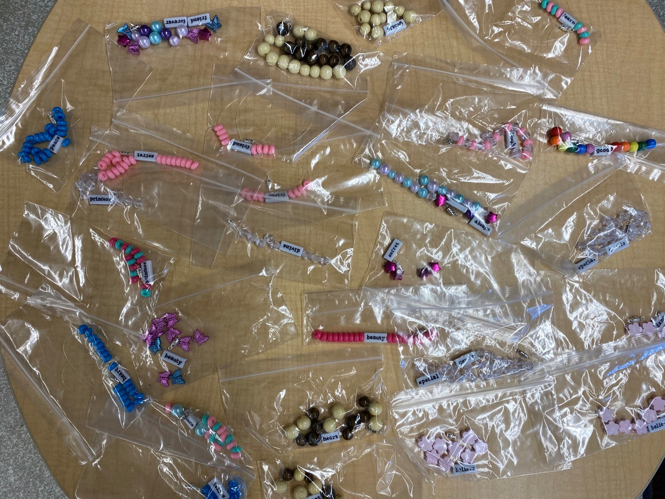
Arla’s Amazing Necklaces
$3.50
Pretty and plain necklaces.
Order from Arla

Slide 10
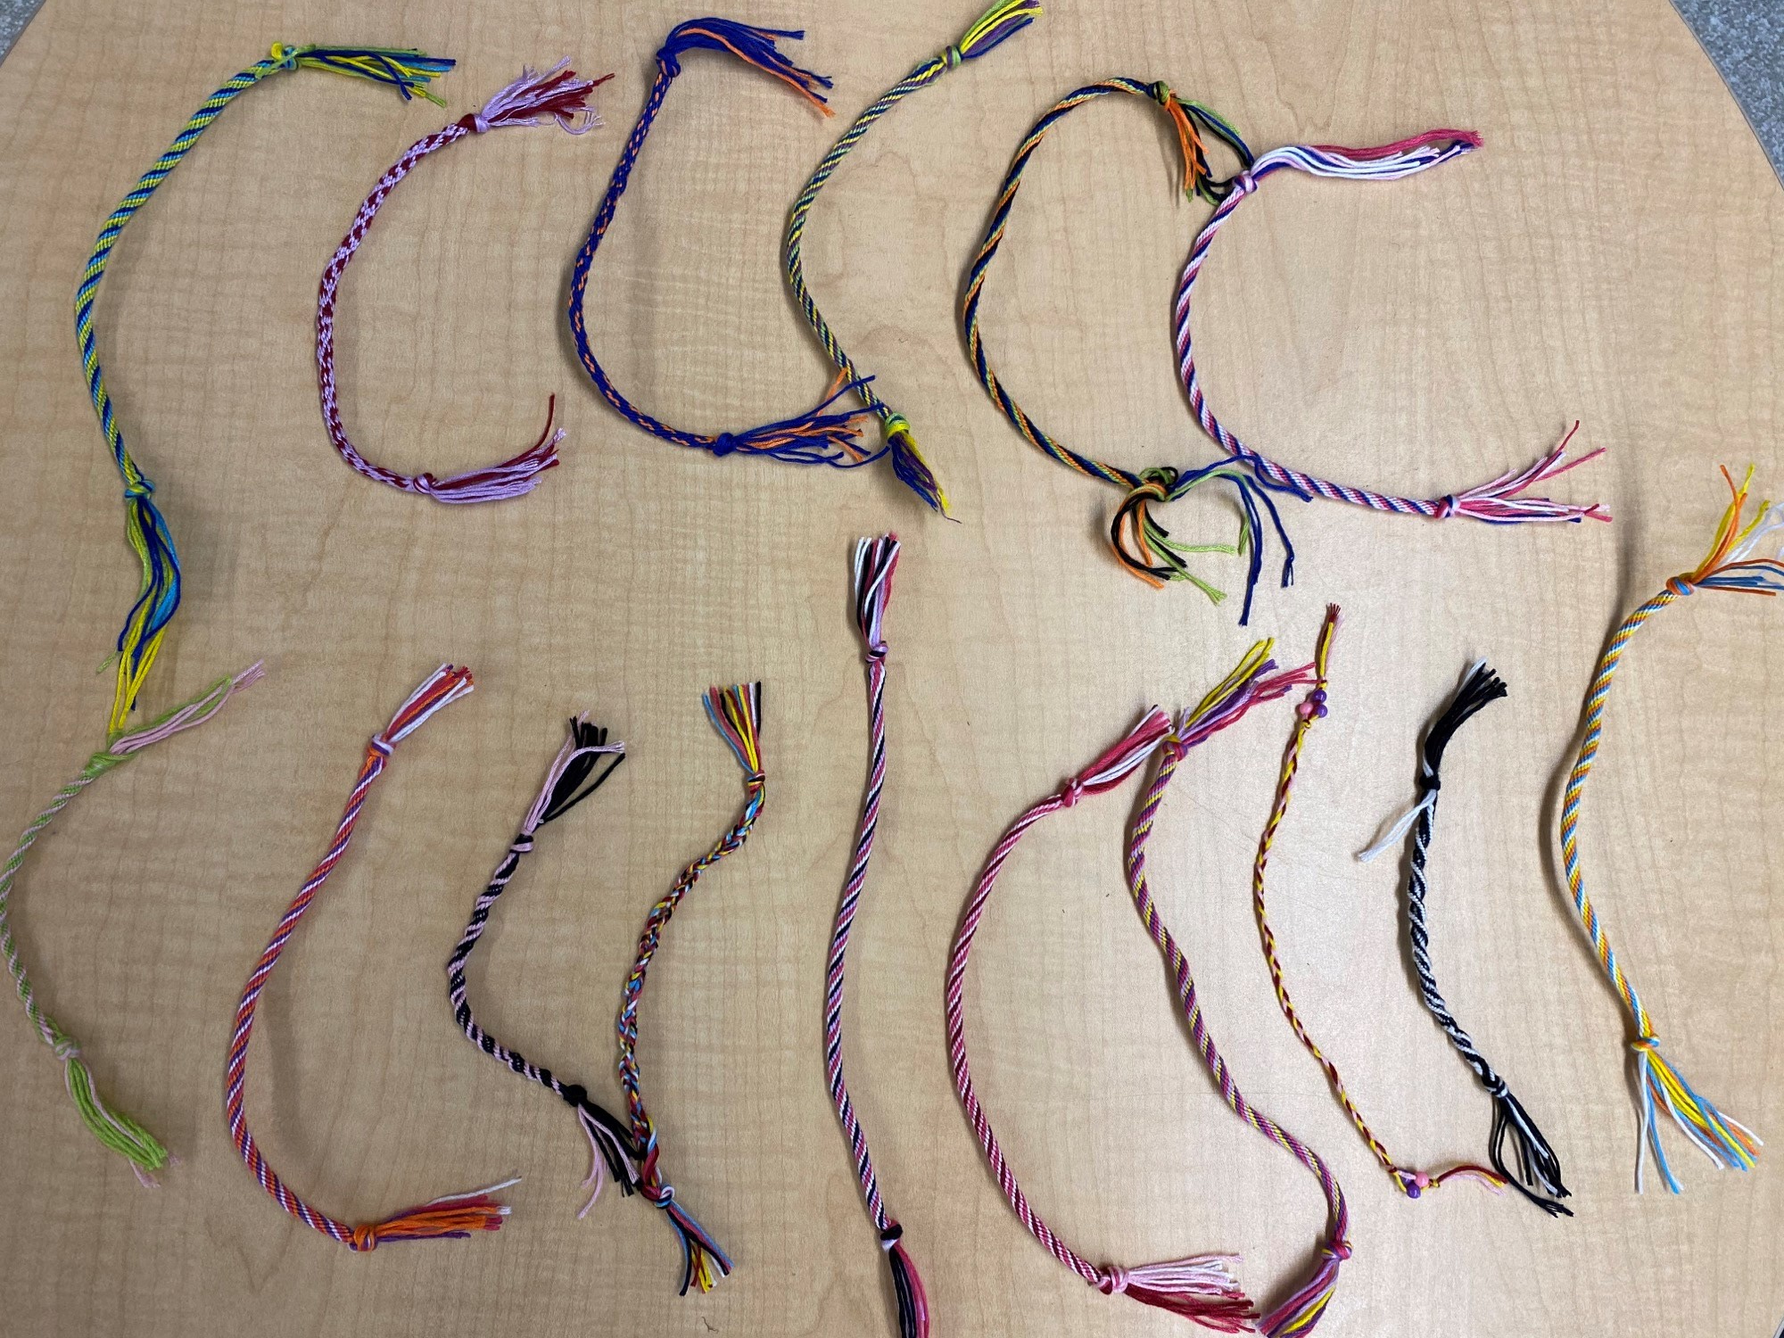
Beadcatchers
$4.00
Order from Addy

Slide 11
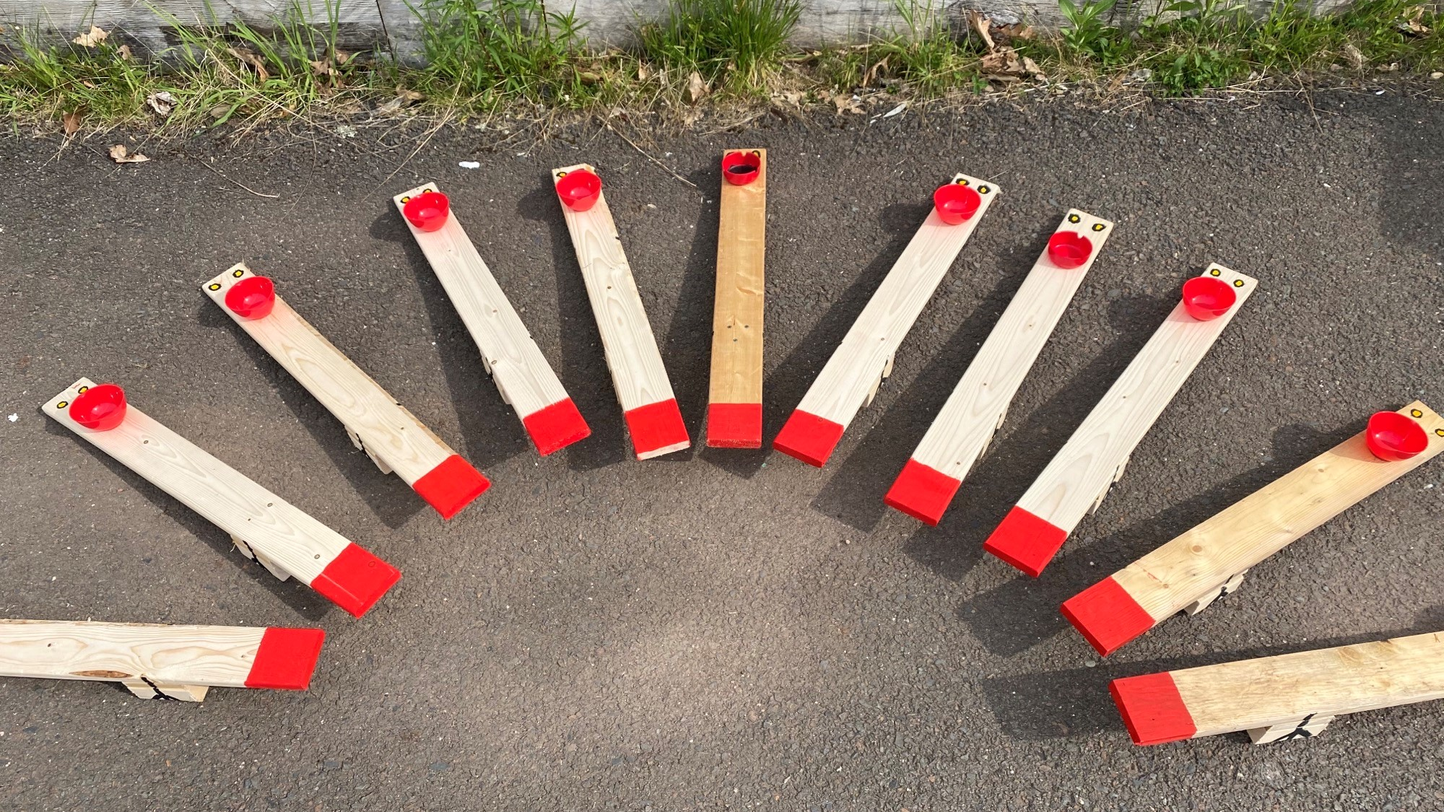
The Chickapultes
$4.25
+ $0.50 if you would like to add a tennis ball
Order from Beckett

Slide 12
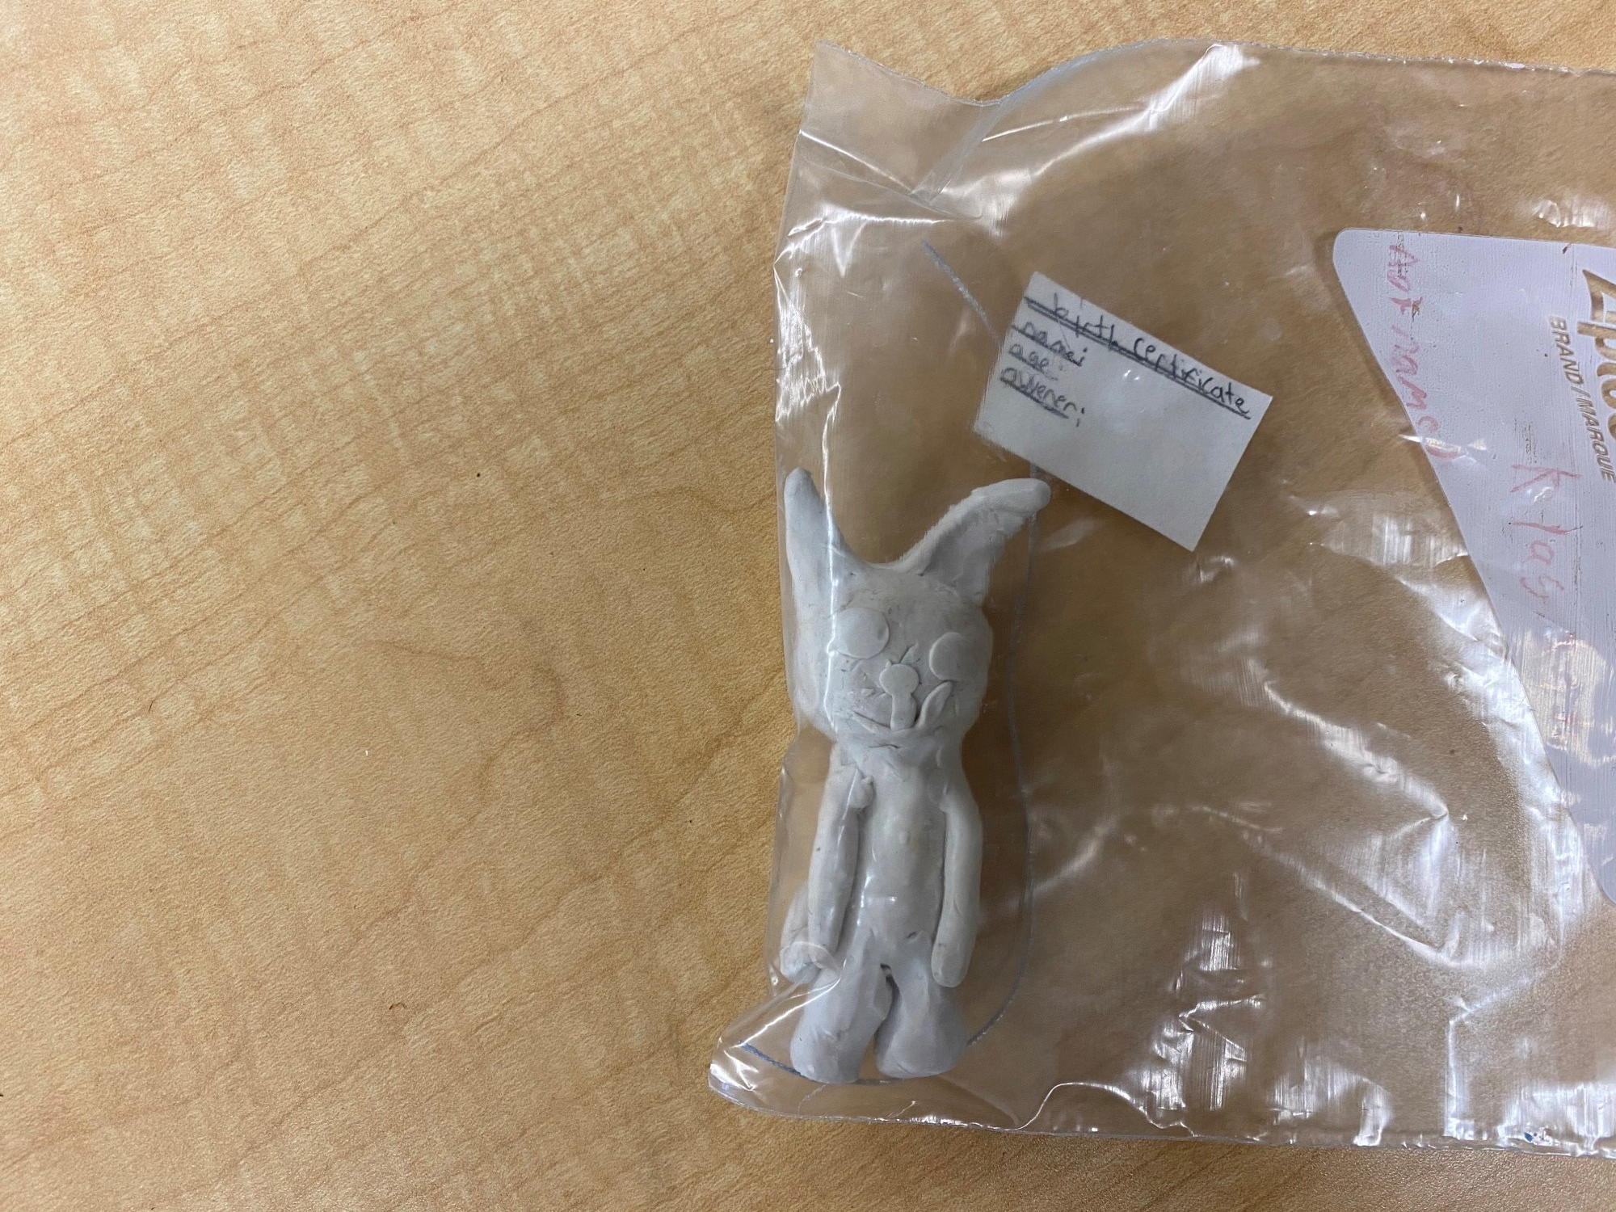
Klay Kats!
$2.00
Paint your own cat
Order from Lyla

Slide 13
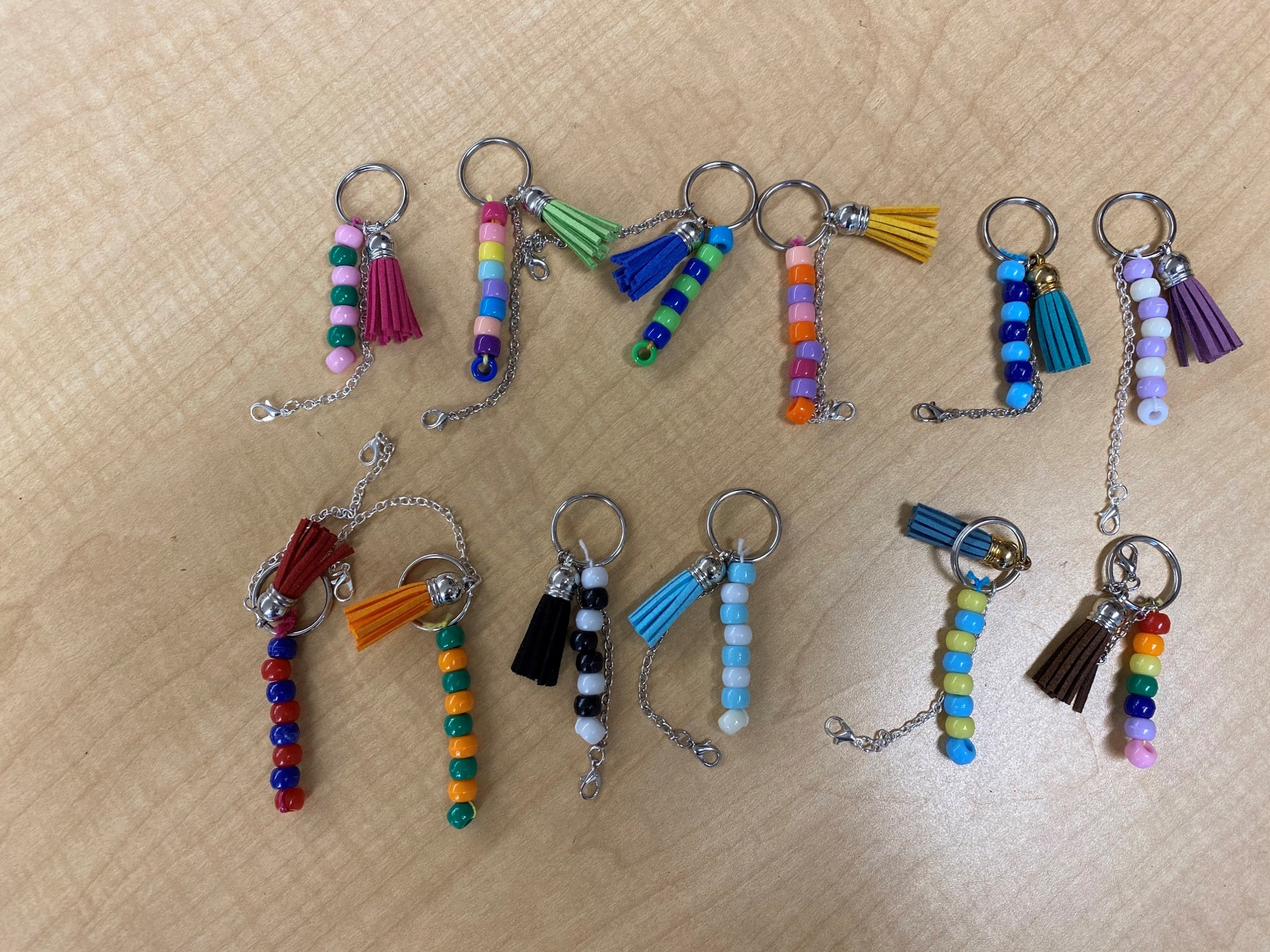
Kool
Keychains
$2.50
Kool beaded keychains
for any occasion!
Order from Nevada

Slide 14
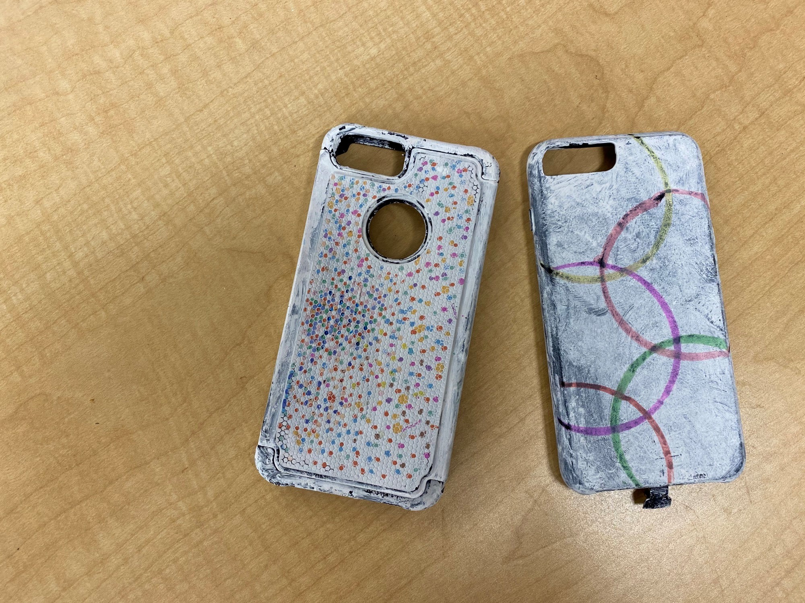
Custom Phone Cases
Fit iPhone 8 Phones
$6.00
Order from Teagan

Slide 15
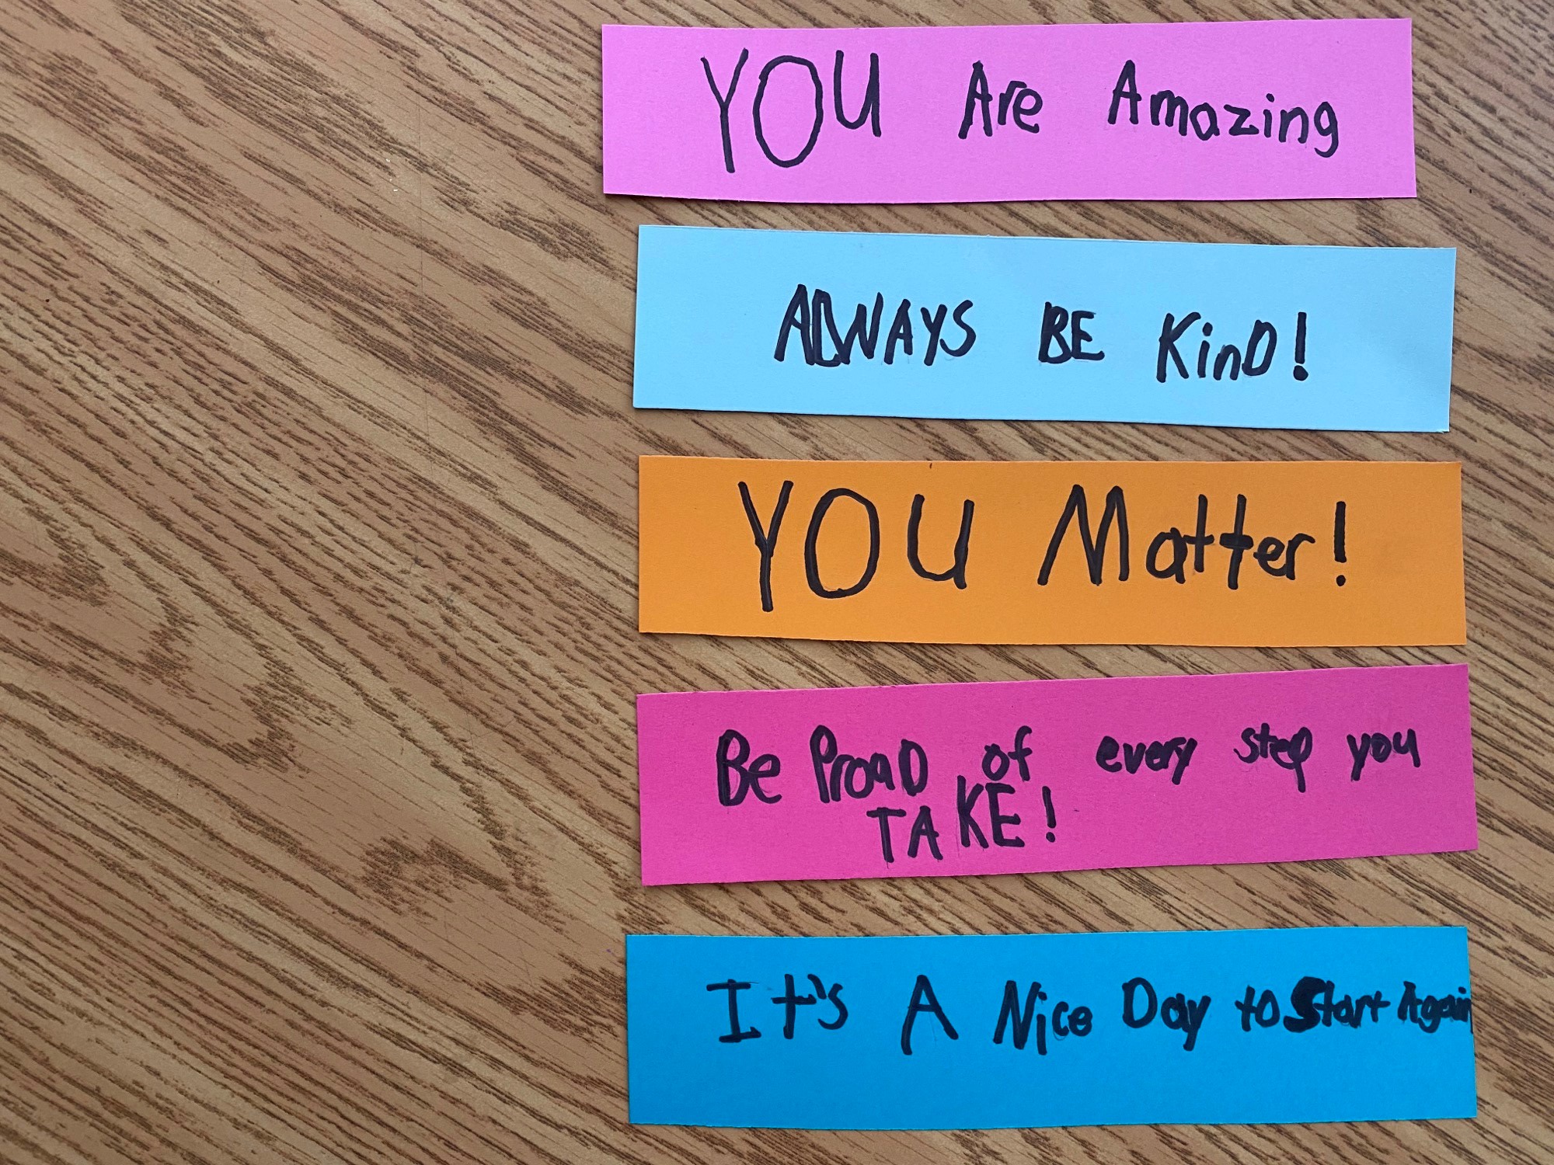
James Marks
0.50 Cents Each
Order from James

